Slide 1
Indexing Structures for Files

Slide 2
A file already exists with some primary organization such as the unordered, ordered, or hashed organizations.
Additional auxiliary access structures called indexes which are used to speed up the retrieval of records in response to certain search conditions.
The index structures are additional files on disk that provide secondary access paths, which provide alternative ways to access the records without affecting the physical placement of records in the primary data file on disk. They enable efficient access to records based on the indexing fields that are used to construct the index.
To find a record or records in the data file based on a search condition on an indexing field, the index is searched, which leads to pointers to one or more disk blocks in the data file where the required records are located.
Every index has 2 field : indexing field and pointer to the block

Slide 3
Types of single-level ordered indexes
Primary
Secondary
Clustering
Multilevel tree-structured indexes
B trees
B+ trees

Slide 4
Types of Single-Level Ordered Indexes
The idea behind an ordered index is similar to that behind the index used in a textbook.
For a file with a given record structure consisting of several fields (or attributes), an index access structure is usually defined on a single field of a file, called an indexing field (or indexing attribute).
The index typically stores each value of the index field along with a list of pointers to all disk blocks that contain records with that field value. The values in the index are ordered so that we can do a binary search on the index.

Slide 5
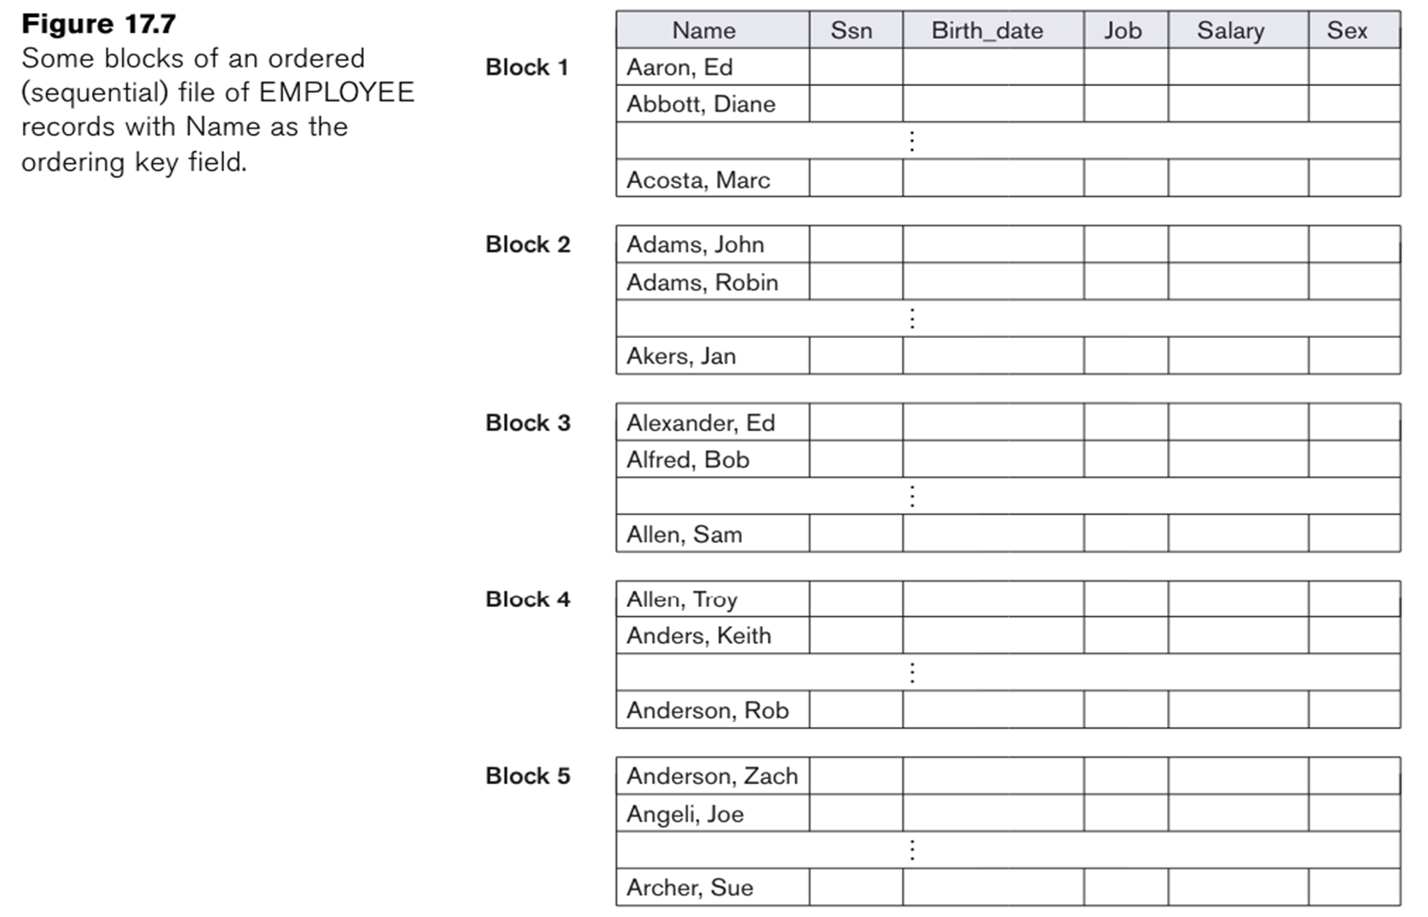

Slide 6
several types of ordered indexes
A primary index is specified on the ordering key field of an ordered file of records. An ordering key field is used to physically order the file records on disk, and every record has a unique value for that field.
If the ordering field is not a key field that is, if numerous records in the file can have the same value for the ordering field another type of index, called a clustering index, can be used.
A secondary index, can be specified on any non-ordering field of a file. A data file can have several secondary indexes in addition to its primary access method.

Slide 7
Primary Index
A primary index is an ordered file whose records are of fixed length with two fields, and it acts like an access structure to efficiently search for and access the data records in a data file.
The first field is of the same data type as the ordering key field called the primary key of the data file, and the second field is a pointer to a disk block (a block address).
There is one index entry (or index record) in the index file for each block in the data file.
Each index entry has the value of the primary key field for the first record in a block and a pointer to that block as its two field values.
The two field values of index entry i as <K(i), P(i)>

Slide 8
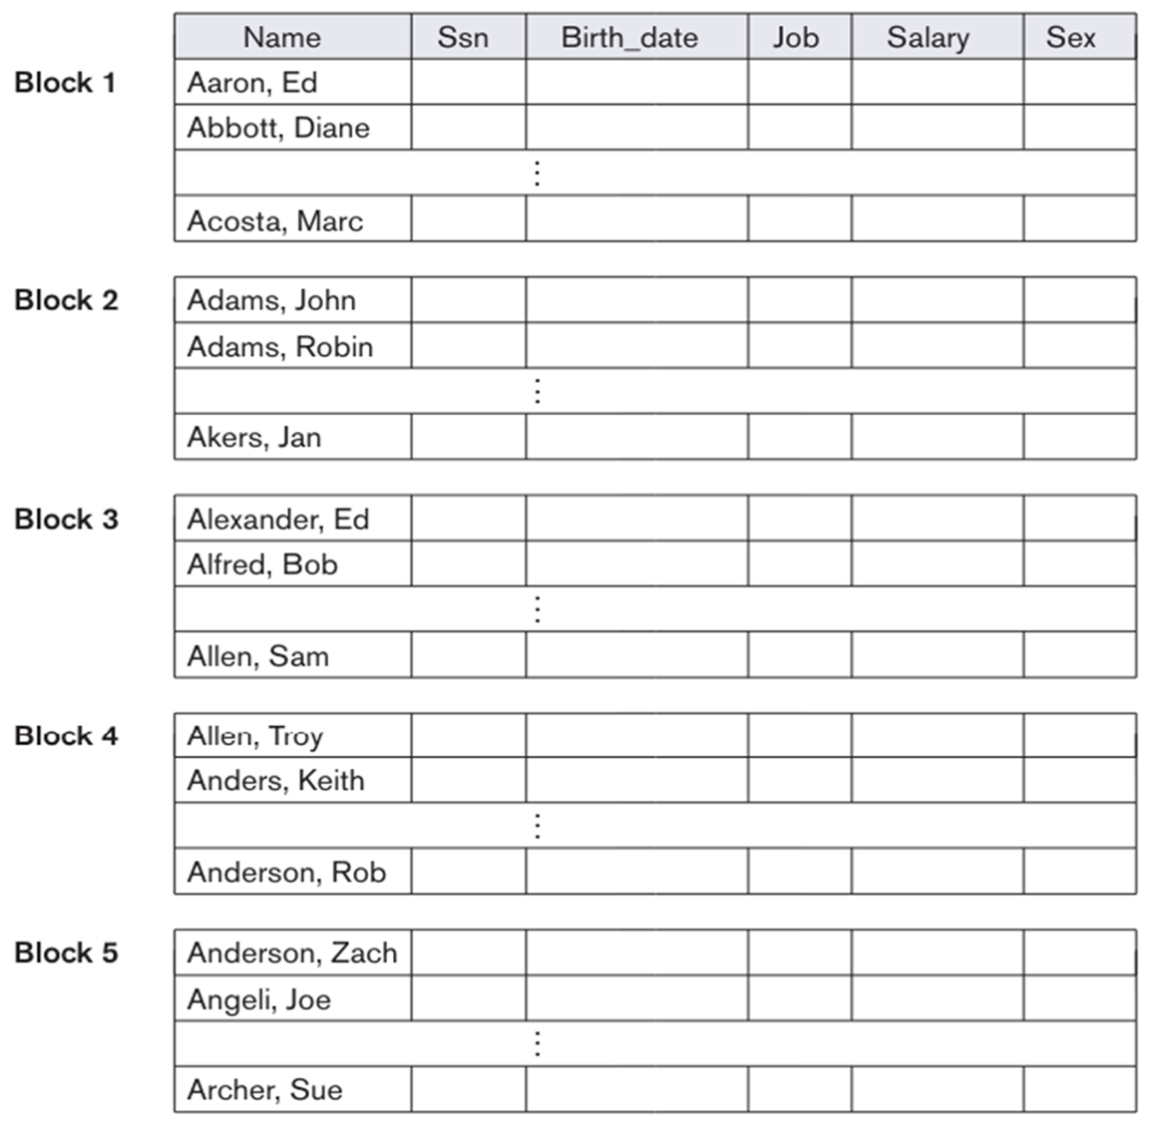
The first three index entries are as follows:
<K(1) = (Aaron, Ed), P(1) = address of block 1>
<K(2) = (Adams, John), P(2) = address of block 2>
<K(3) = (Alexander, Ed), P(3) = address of block 3>

Slide 9
The total number of entries in the index is the same as the number of disk blocks in the ordered data file.
The first record in each block of the data file is called the anchor record of the block, or simply the block anchor.
Indexes can also be characterized as dense or sparse.
  A dense index has an index entry for every search key value (and hence every record) in the data file.
  A sparse (or nondense) index, on the other hand, has index entries for only some of the search values. A sparse index has fewer entries than the number of records in the file.
A primary index is a nondense (sparse) index, since it includes an entry for each disk block of the data file and the keys of its anchor record rather than for every search value (or every record).

Slide 10
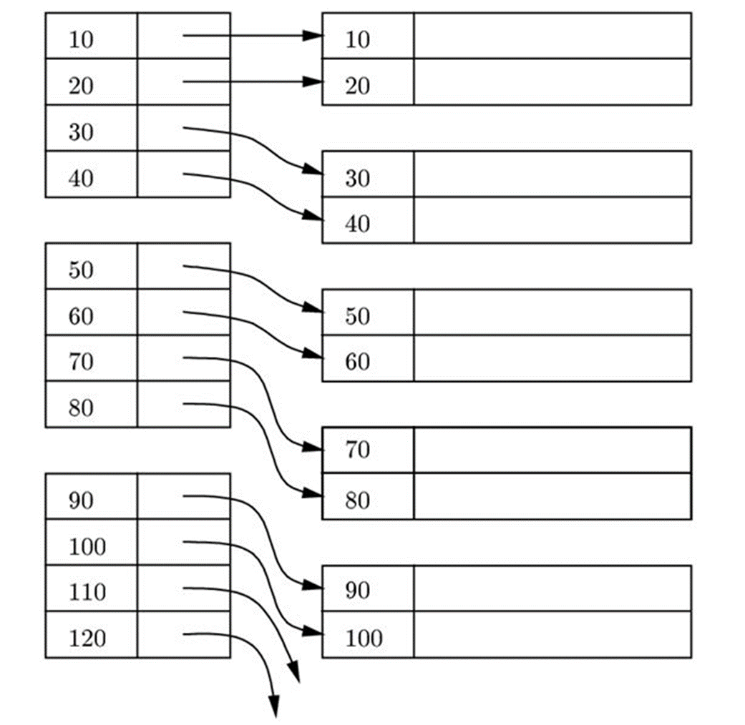

Slide 11
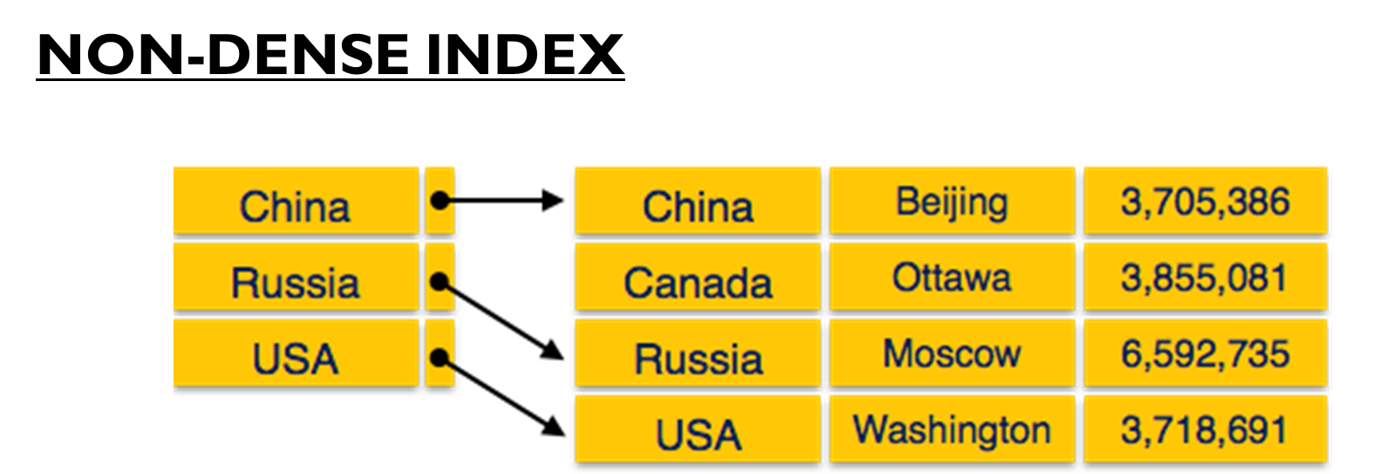

Slide 12
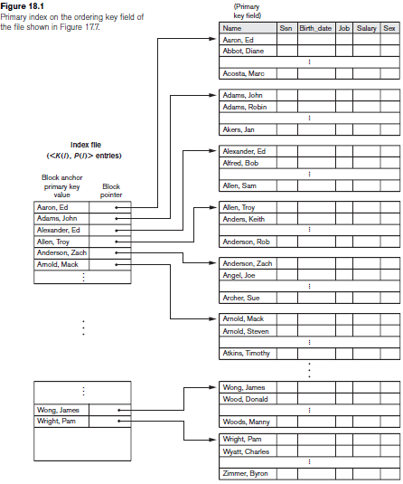
INDEX FILE

Slide 13
The index file for a primary index occupies a much smaller space than does the data file, for two reasons
Firstly, there are fewer index entries than there are records in the data file.
Second, each index entry is typically smaller in size than a data record because it has only two fields; consequently, more index entries than data records can fit in one block.

Slide 14
Clustering Index
If file records are physically ordered on a non-key field which does not have a distinct value for each record that field is called the clustering field and the data file is called a clustered file.
A clustering index, to speed up retrieval of all the records that have the same value for the clustering field.
A clustering index is also an ordered file with two fields; the first field is of the same type as the clustering field of the data file, and the second field is a disk block pointer.
There is one entry in the clustering index for each distinct value of the clustering field, and it contains the value and a pointer to the first block in the data file that has a record with that value for its clustering field.

Slide 15



Slide 16
To alleviate the problem of insertion, it is common to reserve a whole block (or a cluster of contiguous blocks) for each value of the clustering field; all records with that value are placed in the block (or block cluster).
A clustering index is another example of a non-dense index because it has an entry for every distinct value of the indexing field, which is a non-key by definition and hence has duplicate values rather than a unique value for every record in the file.

Slide 17
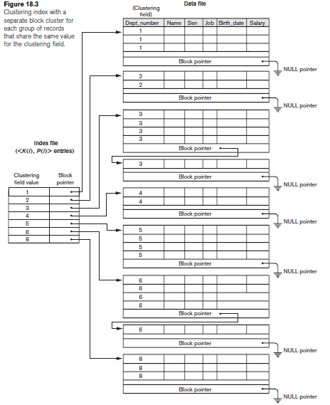

Slide 18
Secondary Index
A secondary index provides a secondary means of accessing a data file for which some primary access already exists. The data file records could be ordered, unordered, or hashed.
The secondary index may be created on a field that is a candidate key and has a unique value in every record, or on a non-key field with duplicate values.
The index is again an ordered file with two fields. The first field is of the same data type as some non-ordering field of the data file that is an indexing field. The second field is either a block pointer or a record pointer.
Many secondary indexes (indexing fields) can be created for the same file each represents an additional means of accessing that file based on some specific field.

Slide 19
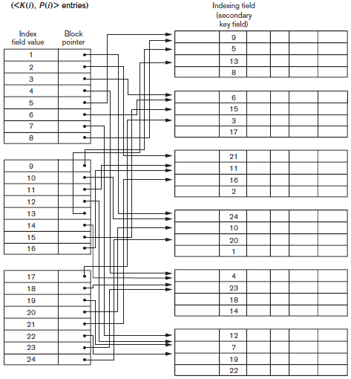

Slide 20
First we consider a secondary index access structure on a key (unique) field that has a distinct value for every record. Such a field is sometimes called a secondary key.
In this case there is one index entry for each record in the data file, which contains the value of the field for the record and a pointer either to the block in which the record is stored or to the record itself. Hence, such an index is dense.
Because the records of the data file are not physically ordered by values of the secondary key field, we cannot use block anchors. That is why an index entry is created for each record in the data file, rather than for each block, as in the case of a primary index.

Slide 21
The entries are ordered by value of K(i), so we can perform a binary search. Because the records of the data file are not physically ordered by values of the secondary key field, we cannot use block anchors.
We can also create a secondary index on a non-key, non-ordering field of a file. In this case, numerous records in the data file can have the same value for the indexing field.

Slide 22
